Slide 1



EYFS Assessment and using Tapestry

Slide 2
Why we assess.
How we do it.
What the Tapestry programme is.
What an observation should look like.
How you can access Tapestry.

Slide 3
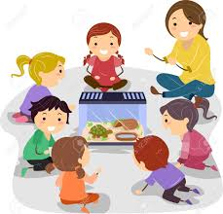
We need to know your child and what he/she can do, so that we can plan learning.
Early Years Foundation Stage (EYFS) sets complex assessments in 7 different areas (subdivided further).
At the end of the year we want every child to reach a “good level of development.”

Slide 4
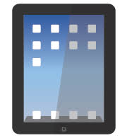
Across Reception we use an online learning journal called Tapestry.
This replaces paper-based learning journals that your child may have had in Nursery or pre-school.
At the end of the academic year you will be able to download a copy of your child’s journal.

Slide 5
Why Tapestry?
Tapestry is currently considered the best online system within EYFS settings.
Stoke Cannon Primary School, which is part of our Three Rivers Federation, has used it during the last two academic years and we successfully used it this past year.

Slide 6

Teachers and TAs have iPads in the classroom with the Tapestry app on them. Each member of staff has a unique login to enable them to access the pupils learning journal.
When an adult observes your child making a step in their learning they write an observation.
Sometimes a photograph or video will be attached.
We add one or more of the assessment points that it links to – this helps our assessment procedure. You do NOT need to do this.

Slide 7
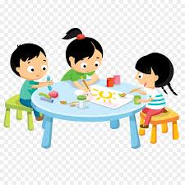
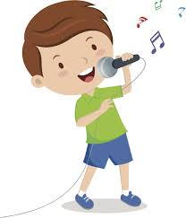
An observation will include -
Date
Brief description of the task
The learning that took place during the activity
The relevant EYFS statements
Photograph/video
We may post a film of the class singing a song in a music lesson, the sound they are learning in phonics or a photograph of an art project etc.

Slide 8
Getting you involved…
Upon starting in Reception we will activate your parent login so you will then be able to see your child’s observations via e-mail.
It then gives you some glimpses into what is happening in school.
You can then add your observations too.

Slide 9

The number of observations will vary….
Observations are being written in a busy environment and every effort will be made to ensure there are no typos. All observations will be checked and proof read by the class teacher before they are activated and sent to you.

Slide 10
The next steps?
The key thing is that we always respect confidentiality.
You will often see other children’s pictures on photos linked to observations.
Please ensure you do not share pictures or videos on social media.

Slide 11
The next step?
You need to make sure we have your current email address.
When your child starts in Reception you will receive an email from Tapestry containing your unique login details.
You will only be able to access your child’s learning journal and not the whole class.
You will then receive email alerts informing you to have a look at the observations that have happened that week.

Slide 12
How can parents use Tapestry?
1. You can write a positive comment or give positive feedback about the learning taking place or add anything that you feel could add more insight into the observation.

Slide 13
How can parents use Tapestry?
2. You can upload any photographs or short videos of a family day out, your child riding a bike, reading a book at home or a religious festival or family celebration.
The teacher/TA can then look at this with your child in class or show any relevant photos / short films.

Slide 14
Example 1
Johnny came downstairs this morning, having put on his uniform – including his socks and trousers. He was not able to do this last month. With a bit of help doing up his buttons he had dressed all by himself.

Slide 15
Example 2
Johnny pointed to the sign in Tesco – “I can see a ‘j’ that is for jam, there’s the jam – it says j-a-m.”

Slide 16
Tapestry website:
https://tapestryjournal.com
Any questions please speak to a member of the Class R team?

